Slide 1
Wireless ATM (Asynchronous Transfer Mode)
Prepared By
POPY DAS

Slide 2
ATM
ATM stands for Asynchronous Transfer Mode and ATM is a switching technique that uses time division multiplexing for the communication of the data and it is a connection-oriented technology. Data is converted in the fixed and small-size cells in the ATM.
Time-division multiplexing (TDM) is a method in which multiple data streams are put onto a single signal by separation of the signal into different segments and a short duration is assigned to each.
In ATM networks, the data is divided into small, fixed length units called cells. The cell is 53 bytes.
An ATM cell which consists of a 48-byte payload and 5 bytes for the header.
Asynchronous Transfer Mode is established for the networks that can carry conventional data traffic that has high throughput and real-time and low-latency data such as video and voice.

Slide 3
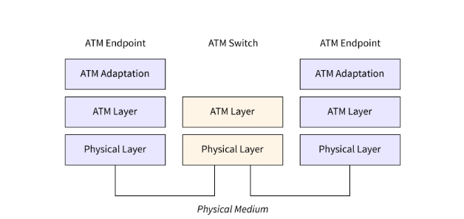
Figure 1: ATM’s functional reference model

Slide 4
Wireless ATM
Wireless ATM (WATM) is a wireless network with an ATM core.
Data, video, and voice are supported by WATM with the guaranteed QoS (Quality of Service).
Like other available wireless technologies, Broadcasting is done by the ATM cells from the base station and transferred to the mobile terminals, and the mobility function is performed by the ATM switch here.

Slide 5
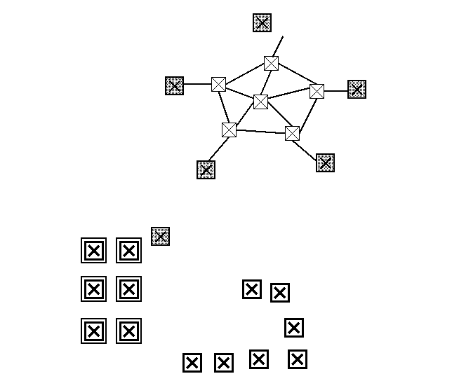
Wireless ATM Reference Models
Figure 2: WATM reference model
Notes:
The overall system consists of a fixed ATM network infrastructure and a radio access segment. In the fixed ATM network, the switches, which communicate directly with wireless station or wireless end user devices, are mobility enhanced ATM switches. These switches setup connections on behalf of the wireless devices. They serve as the "entrance" to the infrastructure wired ATM networks. The other ATM switching elements in the wired ATM networks remain unchanged.Based on the different types of wireless applications, the radio access segment falls into a number of areas which may need different solutions.

Slide 6
Fixed Wireless Components
The end user devices and switching devices are fixed
They establish connections with each other via wireless channel, not through cable
The data transmissions are wireless, yet without mobility
Design issues, e.g. handover, location management, and re-routing, are not presented.
Mobile End Users
PCS, and wireless LANs, the end user devices, which are mobile, communicate directly with the fixed network switching devices via wired or wireless channels.
To support the ATM connections, the end user devices are required to be equipped with a Wireless Terminal Adaptor which communicates with the Wireless Access Point in the fixed switching elements.
Notes:
1. Fixed Wireless Components
In fixed wireless LANs, or network interconnection via satellite or microwaves links, the end user devices and switching devices are fixed. They establish connections with each other via wireless channel, not through cable. In these kinds of applications, the data transmissions are wireless, yet without mobility. Since the user devices do not roam around, some design issues, e.g. handover, location management, and re-routing, are not presented. 2. Mobile End Users
In digital cellular, PCS, and wireless Lans, the end user devices, which are mobile, communicate directly with the fixed network switching devices via wired or wireless channels. To support the ATM connections, the end user devices are required to be equipped with a Wireless Terminal Adaptor which communicates with the Wireless Access Point in the fixed switching elements (mobility enhanced ATM switches).

Slide 7
Mobile Switches with Fixed End Users
The end user device and the switch, as a unit, are mobile.
An end user device is fixed to one switch instead of roaming around different switches.
The switch is responsible to establish connections with the fixed infrastructure network component, either through wired channel or wireless channel.
Mobile Switches with Mobile End Users
End user devices are mobile.
When the end user wants to establish a connection, it first setups a connection with a mobile switch, which then setups a connection with the fixed network switches, either directly, or via another mobile switches.
Notes:
3. Mobile Switches with Fixed End Users
End user devices are connected to switches via wired or wireless channels. The end user device and the switch, as a unit, are mobile. There can be more than one end user devices attach to one switch. An end user device is fixed to one switch instead of roaming around different switches. The switch is responsible to establish connections with the fixed infrastructure network component, either through wired channel or wireless channel. In this case, Wireless Access Points and Wireless Terminal Adapters are needed by the fixed mobility enhanced ATM switches and the mobile switches.
4. Mobile Switches with Mobile End Users
In this case, end user devices are mobile. There are also some mobile switching elements. When the end user wants to establish a connection, it first setups a connection with a mobile switch, which then setups a connection with the fixed network switches, either directly, or via another mobile switches. Wireless Access Points and Wireless Terminal Adapters are also needed to support the mobility.

Slide 8
Interworking with PCS
The users are PCS terminals.
PCS terminals send data to proper PCS base stations via wireless link, which then establish connections to the fixed network switching elements through a base station controller.
The base station controller is a logical element which function as the ATM to PCS translator.
Wireless Ad Hoc Networks
An Ad Hoc network is the cooperative engagement of a collections of mobile terminals without the required intervention of any centralized access point.
An auto-configuration of a wireless ATM network will be required for this kind of application.
In wireless Ad Hoc Networks, an end user can communicate with the mobility enhanced ATM switches either directly, or via a central controller.
Notes:
5. Interworking with PCS
In PCS networks, the users are PCS terminals. PCS terminals send data to proper PCS base stations via wireless link, which then establish connections to the fixed network switching elements through a base station controller. The base station controller is a logical element which function as the ATM to PCS translator. 6. Wireless Ad Hoc Networks
An Ad Hoc network is the cooperative engagement of a collections of mobile terminals without the required intervention of any centralized access point. An auto-configuration of a wireless ATM network will be required for this kind of application. In wireless Ad Hoc Networks, an end user can communicate with the mobility enhanced ATM switches either directly, or via a central controller.

Slide 9
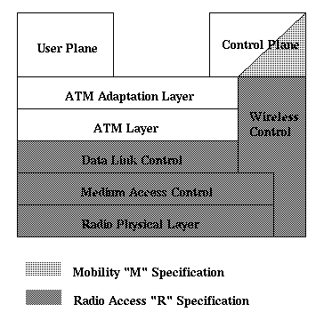
Wireless ATM Protocol Architecture
Figure 3: WATM Protocol Architecture

Slide 10
The WATM items are divided into two distinct parts: Mobile ATM and Radio Access Layer
Mobile ATM is dealing with the higher-layer control/ signaling functions needed to support mobility. These control/ signaling include handover, location management, routing, addressing, and traffic management.
Radio Access Layers consists of PHY (Physical Layer), MAC (Media Access Layer), DLC (Data Link Layer), and RRC (Radio Resource Control). Up to now, only PHY and MAC are under consideration.

Slide 11
Radio Access Layer
Physical Layer (PHY)
While a fixed station may own an 25 Mbit/s up to 155 Mbit/s data rate ATM link, a 25 Mbit/s data link in a wireless environment is currently difficult to implement.
A several GHz spectrum would be required to provide high speed wireless transmission.
Currently, 5 GHz band is considered to be used to provide 51 Mbit/s channel with advanced modulation and special coding techniques.
Although 155 Mbit/s is unreachable due to the limitation of today's techniques, people believe that it will soon be available in the 60 GHz band and 622 Mbit/s would be reached in the not-too-distant future.
Based on this belief, two separate PHY layer specifications are recommended, one for 5 GHz band, one for the 60 GHz band since they will require different operations.

Slide 12
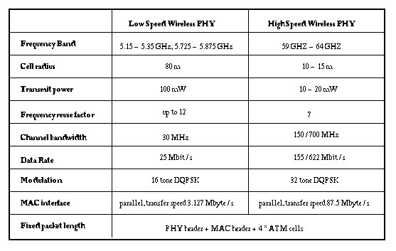
Figure 4: Specific requirements for PHY layer

Slide 13
2. Media Access Control (MAC)
WATM MAC is responsible for providing functionally point to point links for the higher protocol layer to use.
To identify each station, both IEEE 48 bit address and local significant address, which is assigned dynamically within a cell, are allowed.
Each station registers it's address to it's hub during a hub initiated slotted-ALOHA content period for new registration so that make itself know by others.
In a shared environment, there must be some control over the usage of the medium to guarantee QoS. An extended TDMA, which satisfies PCR (Peak Cell Rate), SCR (Sustainable Cell Rate), and MBS (Maximum Burst Size) requests, is suggested. Each station may use the media only when it's informed by the central control elements (hub). Each can send out several packets at a time. To minimum overhead, the MAC should support multiple ATM cells in a packet.
Another design issue of MAC layer is to support multiple PHY layers.
Notes:
WATM MAC is responsible for providing functionally point to point links for the higher protocol layer to use. To identify each station, both IEEE 48 bit address and local significant address, which is assigned dynamically within a cell, are allowed. Each station registers it's address to it's hub during a hub initiated slotted-ALOHA content period for new registration so that make itself know by others. In a shared environment, there must be some control over the usage of the medium to guarantee QoS. An extended TDMA, which satisfies PCR (Peak Cell Rate), SCR (Sustainable Cell Rate), and MBS (Maximum Burst Size) requests, is suggested. Each station may use the media only when it's informed by the central control elements (hub). Each can send out several packets at a time. To minimum overhead, the MAC should support multiple ATM cells in a packet.
Another design issue of MAC layer is to support multiple PHY layers. Currently, people are interested in different wireless bands, which includes infra-red medium, 5 GHz radio band, and 60 GHz band. Different PHY will be need for different medium. WATM MAC should support all of them. Some other design issues like error recovery, support for sleep are also under consideration.

Slide 14
3. Data Link Control (DLC)
Data Link Control is responsible for providing service to ATM layer.
Mitigating the effect of radio channel errors should be done in this layer before cells are sent to the ATM layer.
In order to fulfill this requirement, error detection/retransmission protocols and forward error correction methods are recommended.
Currently, the DLC protocol and syntax, interface to MAC layer, and interface to ATM layer have not been proposed yet.

Slide 15
4. Radio Resource Control (RRC)
RRC is needed for support of control plane functions related to the radio access layer.
It should support radio resource control and management functions for PHY, MAC, and DLC layers.
The design issues of RRL will include control/management syntax for PHY, MAC and DLC layers; meta-signaling support for mobile ATM; and interface to ATM control plane.

Slide 16
Mobile ATM
Handover
In WATM networks, a mobile end user establish a virtual circuit (VC) to communicate with another end user. When the mobile end user moves from one AP (access point) to another AP, proper handover is required.
To minimize the interruption to cell transport, an efficient switching of the active VCs from the old data path to new data path is needed.
Also the switching should be fast enough to make the new VCs available to the mobile users.
When the handover occurs, the current QoS may not be support by the new data path. In this case, a negotiation is required to set up new QoS.
During the handover, an old path is released and a new path is then re-established.
Cell buffering is used to guarantee that no cell is lost and cell sequence is preserved.
Cell buffering consists of Uplink Buffering and Downlink Buffering.
Notes:
In WATM networks, a mobile end user establish a virtual circuit (VC) to communicate with another end user (either mobile or ATM end user). When the mobile end user moves from one AP (access point) to another AP, proper handover is required. To minimize the interruption to cell transport, an efficient switching of the active VCs from the old data path to new data path is needed. Also the switching should be fast enough to make the new VCs available to the mobile users.When the handover occurs, the current QoS may not be support by the new data path. In this case, a negotiation is required to set up new QoS. Since a mobile user may be in the access range of several APs, it will select the one which can provides the best QoS.
During the handover, an old path is released and a new path is then re-established. There is a possibility that some cells will get lost during this process (when the connection is broken). In case no cell lost is allowed. Cell buffering is used to guarantee that no cell is lost and cell sequence is preserved. Cell buffering consists of Uplink Buffering and Downlink Buffering. If VC is broken when the mobile user is sending cells to APs, Uplink Buffering is required. The mobile user will buffer all the outgoing cells. When the connection is up, it send out all the buffered cells so no cells are lost unless the buffers is overflowed. Downlink Buffering is performed by APs to preserve the downlink cells for sudden link interruptions, congestion, or retransmissions. It may also occur when handover is executed. There are sever options for downlink buffering based on different handover situations.

Slide 17
2. Location Management
When a connection is needed to be established between an mobile ATM end point and another ATM end point, the mobile ATM end point is needed to be located.
There are two basic location management schemes: the mobile PNNI scheme and the location register scheme.
In the mobile PNNI scheme, when a mobile moves, the reachability update information only propagates to the nodes in a limited region.
In the location register scheme, an explicit search is required to prior to the establishment of connections. A hierarchy of location registers, which is limited to a certain level, is used.
Notes:
When a connection is needed to be established between an mobile ATM end point and another ATM end point, the mobile ATM end point is needed to be located. There are two basic location management schemes: the mobile PNNI scheme and the location register scheme.In the mobile PNNI scheme, when a mobile moves, the reachability update information only propagates to the nodes in a limited region. The switches within the region has the correct reachable information for the mobiles. When a call is originated by a switch in this region, it can use the location information to directly establish the connection. If a call is originated by a switch outside this region, a connect is established between this switch and the mobile's Home Agent, which then forward the cells to the mobile. This scheme decreases the number of signaling messages during a local handover.
In the location register scheme, an explicit search is required to prior to the establishment of connections. A hierarchy of location registers, which is limited to a certain level, is used.

Slide 18
3. Routing
First, mapping of mobile terminal routing-id's to paths in the network is necessary.
Also rerouting is needed to re-establish connection when the mobiles move around.
Addressing
Addressing issue of WATM focuses on the addressing of the mobile terminal.
The current solution is that each mobile terminal has a name and an local address.
The name of the mobile terminal is a regular ATM end system address. It's constant and doesn't change while the terminal moves.
An local (or temporary) address is assigned when the mobile terminal attaches to a different switch during roaming. This switch will assign a local significant address to the terminal.

Slide 19
5. Traffic and QoS Control
The mobility feature puts additional impact on traffic control and QoS control.
Support for dynamic QoS renegotiation and extensions to ABR control policy to deal with handover and other related design issues have not been proposed yet.
6. Wireless Network Management
A specific methods must be designed to maintain the dynamic nature of the network topology.
Other issues, like network and user administration, fault identification and isolation, and performance management, are also need to be considered.

Slide 20
Advantages of Wireless ATM
Benefits of ATM made mobile
Free to roam
Flexible bandwidth allocation
Efficient multiplexing of traffic
Availability of existent ATM switching
Flexibility of reusing same frequency
Soft handoff without any data loss

Slide 21
Disadvantages of wireless ATM
Delay to multi-path interference
Hop-by-hop routing method not adequate
Virtual connection takes longer
Poor physical level characteristics
High noise interference
Finding a suitable wireless channel

Slide 22
References
https://www.scaler.com/topics/asynchronous-transfer-mode/
https://www.cse.wustl.edu/~jain/cis788-97/ftp/wireless_atm/index.html

